Slide 1
CRO deep dive
INTERNAL
File created on: 28-10-2025 18:34:52
INTERNAL

Slide 2
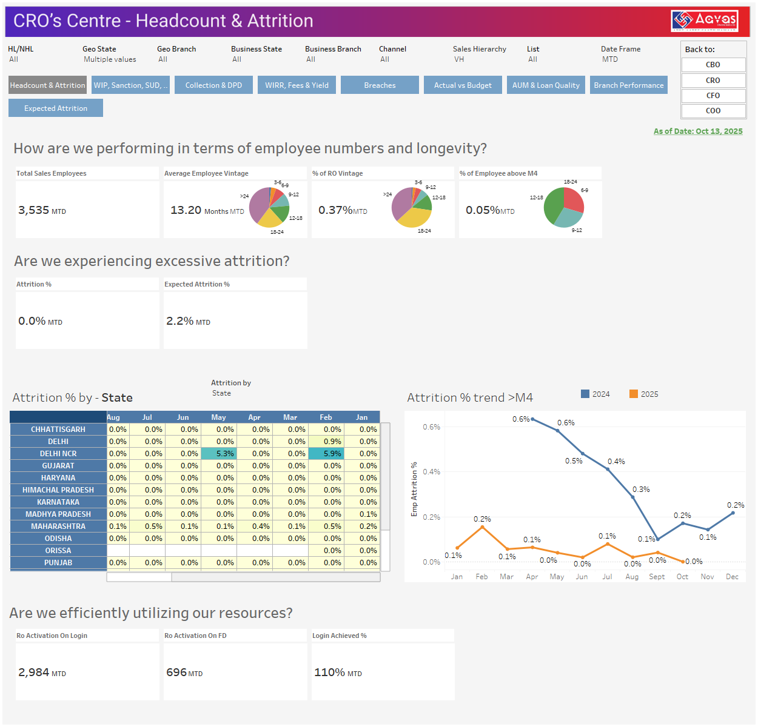
INTERNAL
INTERNAL

Slide 3
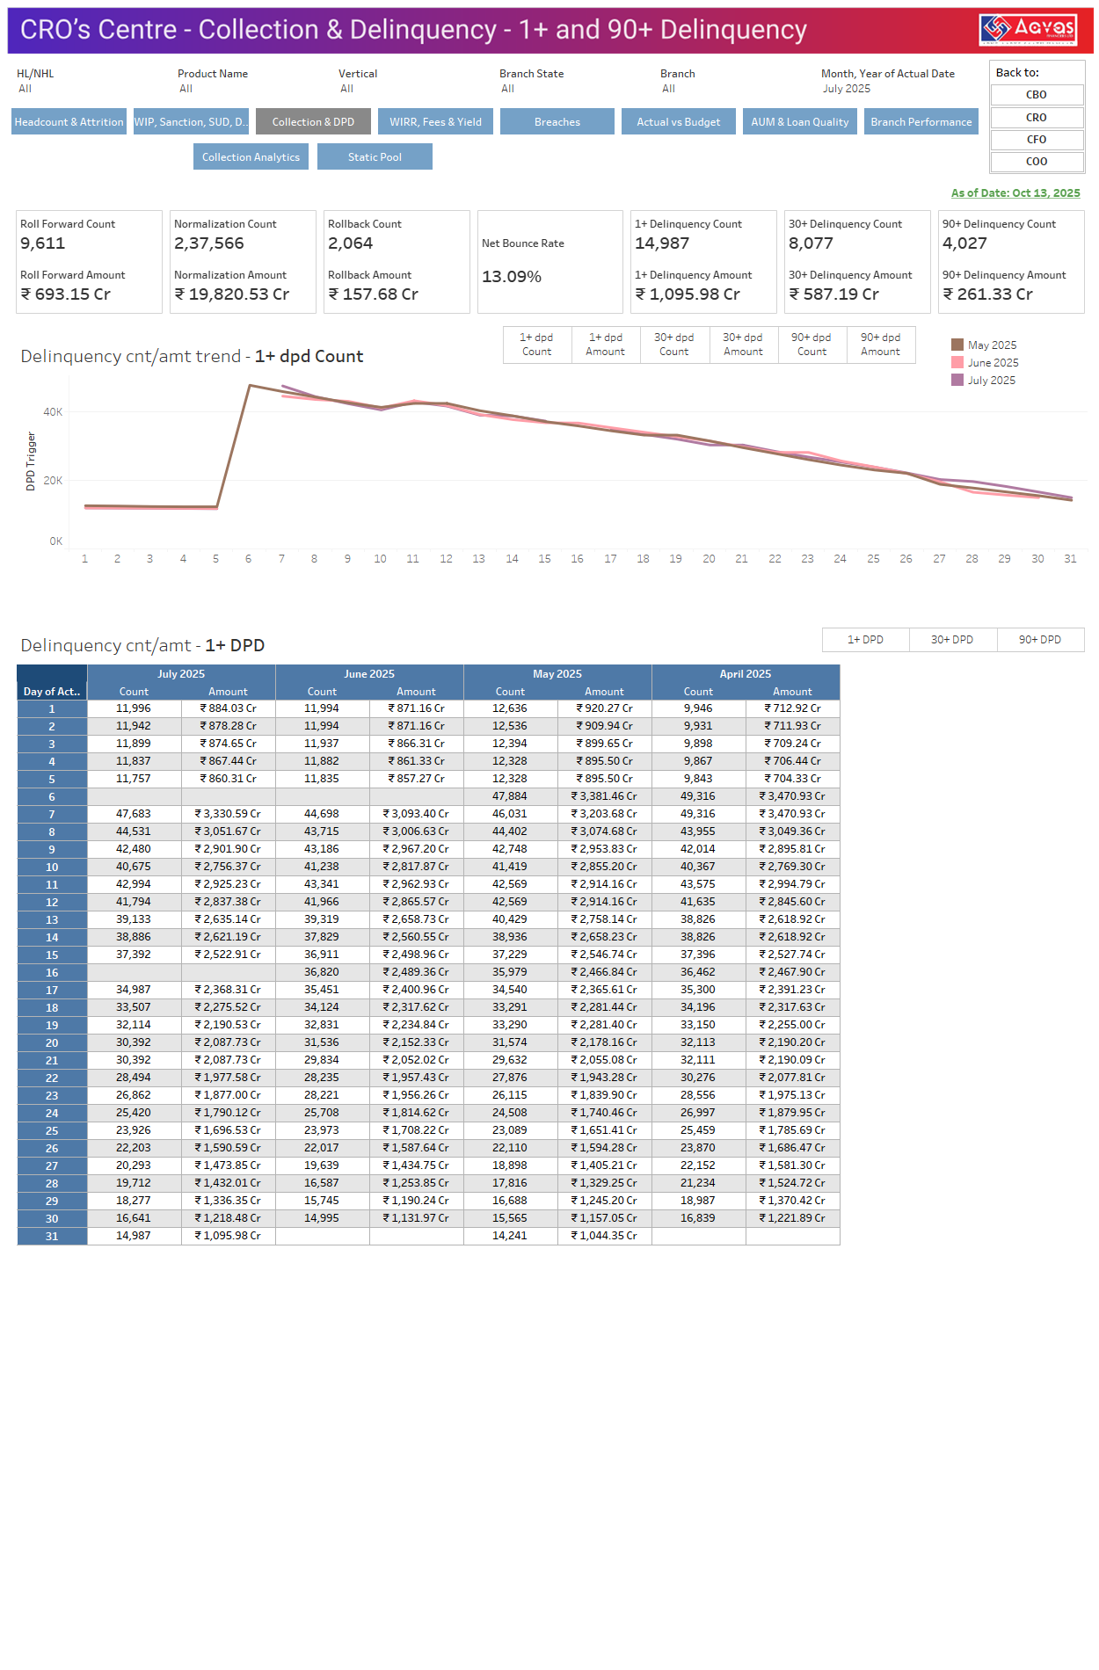
INTERNAL
INTERNAL

Slide 4
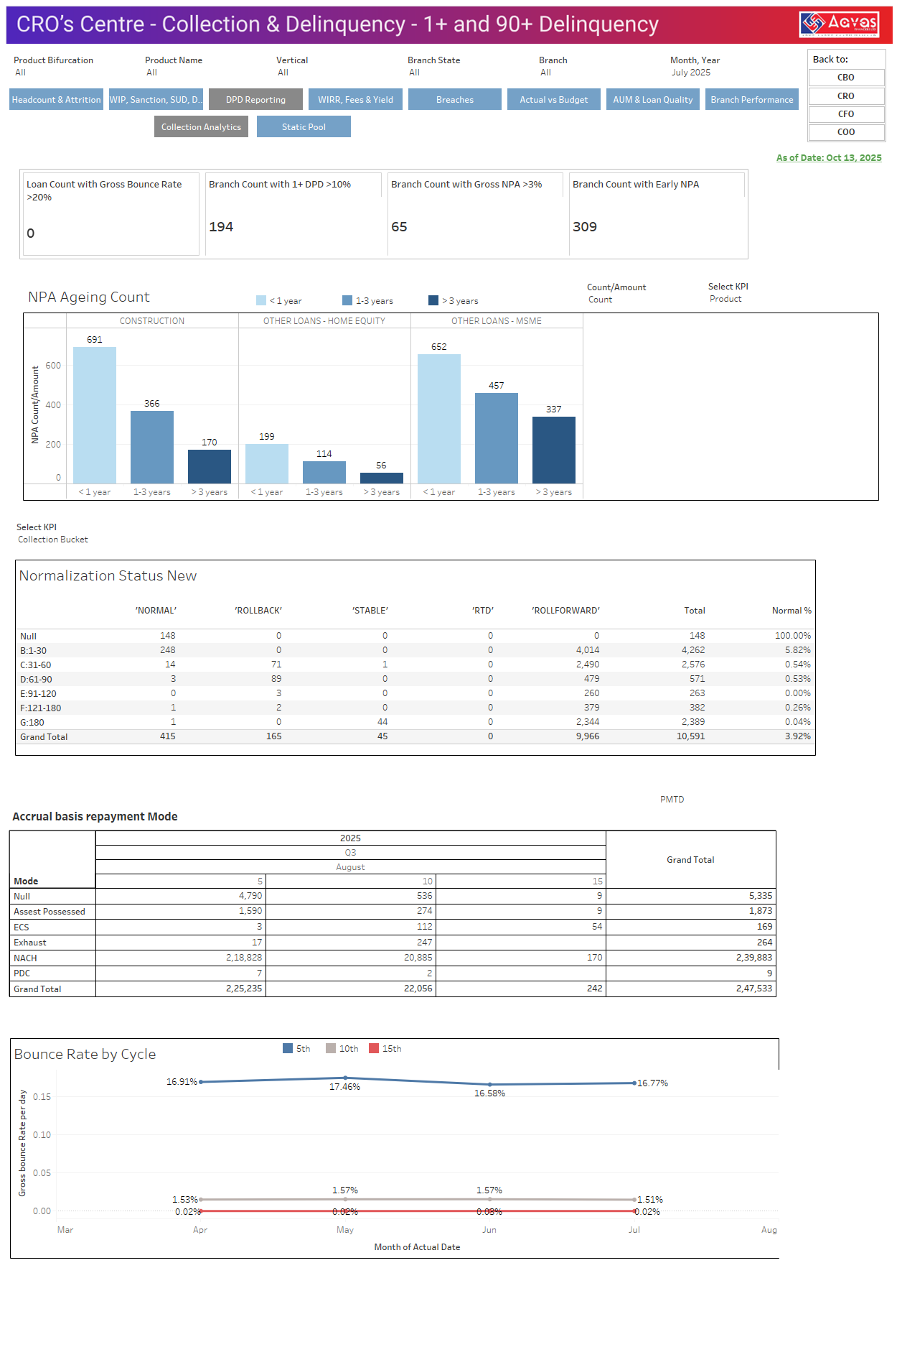
INTERNAL
INTERNAL

Slide 5
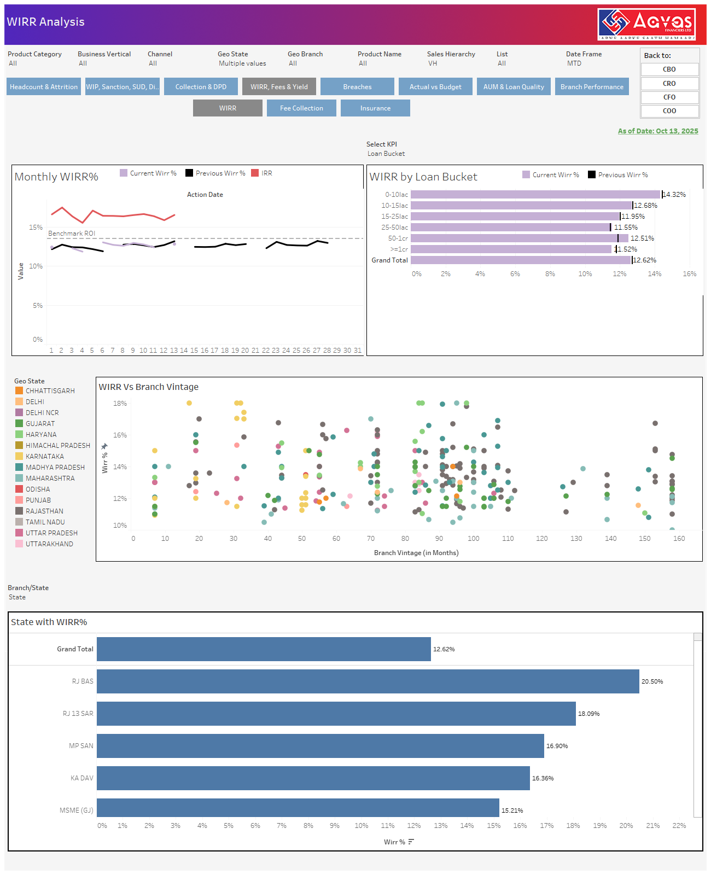
INTERNAL
INTERNAL

Slide 6
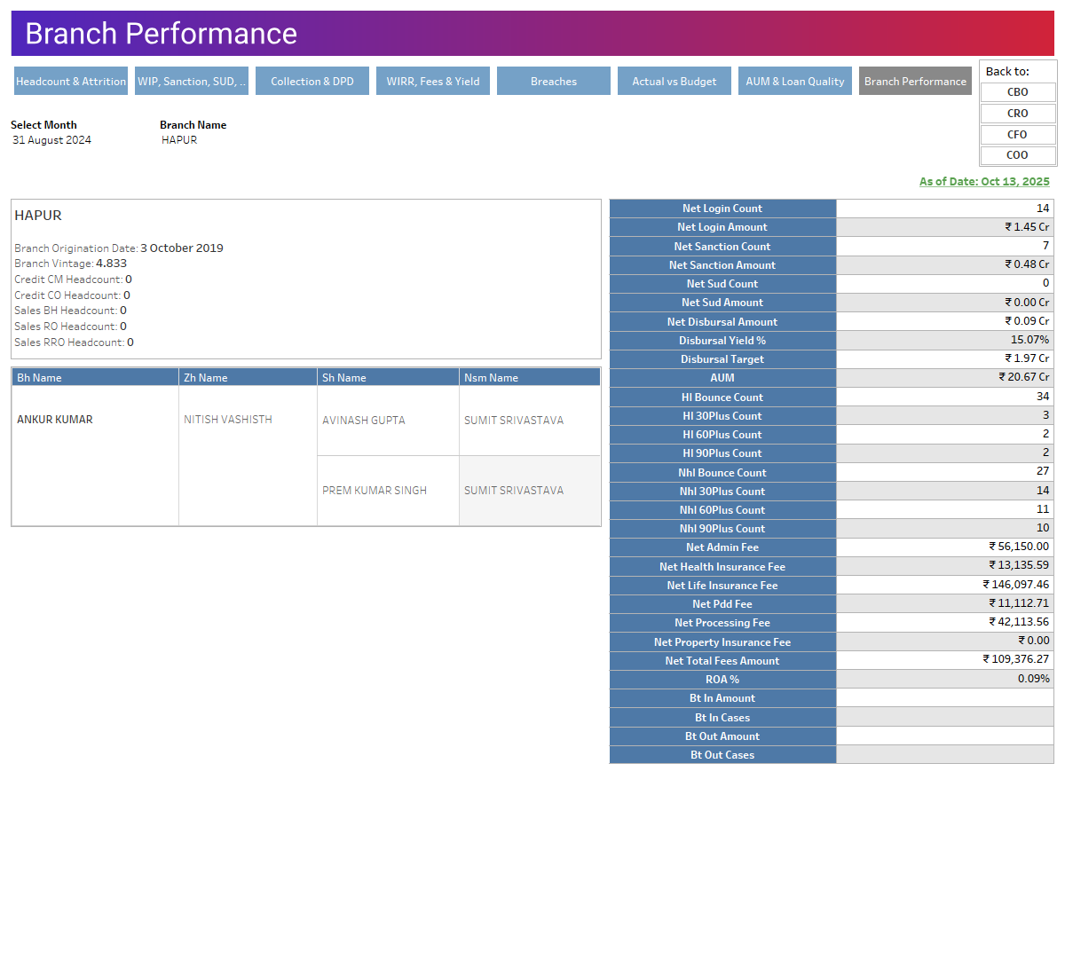
INTERNAL
INTERNAL

